Slide 1


28 Mar 23 IPR
Air Force ROTC Detachment 842
The University of Texas at San Antonio
C/2d Lt Frankie Rodriguez & C/1st Lt Joanna Finley
28 Mar 23

Slide 2


Overview
Event Roles
Guest List
Script
Base Access
Venue Information
Save The Date
Air Force ROTC Detachment 842 • We Build Exceptional Officers • The University of Texas at San Antonio

Slide 3
Event Roles

Slide 4
Event Roles
Program Label: TBD
MC: C/Camelo
Volunteer Team Lead: C/Burns
National Anthem:TBD
Invocation: C/Vallor
Cake: C/Finley
Pictures: C/Rodriguez, PA
Honor guard: Irizarry, Pacheco, Schrecker, Vallor, Scott, Gibson
Air Force ROTC Detachment 842 • We Build Exceptional Officers • The University of Texas at San Antonio

Slide 5
Guest List

Slide 6
Guest List
https://docs.google.com/spreadsheets/d/1GkAbez8I74nKtiv3U-tcTEhE50qgYZ6dIQO3gple3Cs/edit?usp=sharing
Air Force ROTC Detachment 842 • We Build Exceptional Officers • The University of Texas at San Antonio

Slide 7
Script

Slide 8
Script
https://docs.google.com/document/d/1WEbt67J4fBQfoCCdmTNiYKTEXxaAJE1MXdln0bHt61s/edit?usp=sharing
Air Force ROTC Detachment 842 • We Build Exceptional Officers • The University of Texas at San Antonio

Slide 9
Base Access

Slide 10
Base Access
https://docs.google.com/spreadsheets/d/1cO9kuMqpnp-Z0lEm4F0uv4rezsVaa62tyuxkPAKdXmI/edit?usp=sharing
Air Force ROTC Detachment 842 • We Build Exceptional Officers • The University of Texas at San Antonio

Slide 11
Venue Information

Slide 12
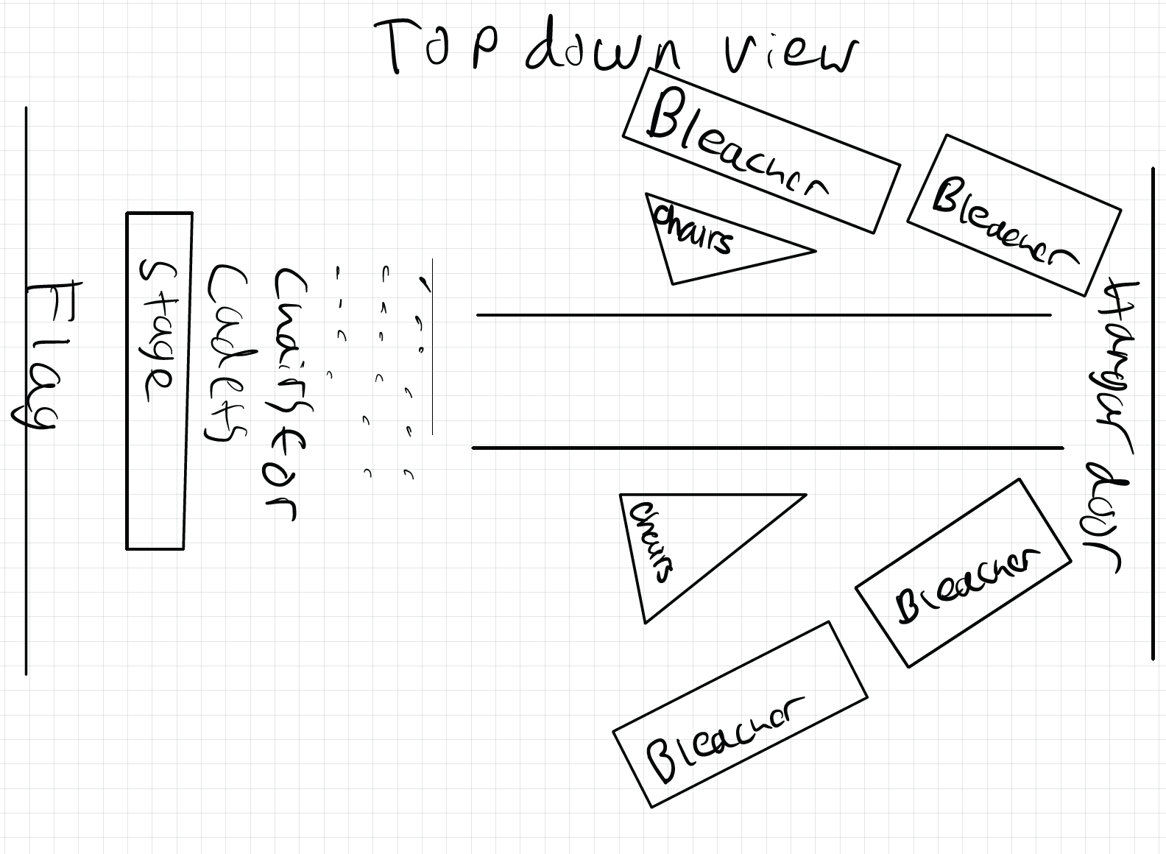
Venue Information
Air Force ROTC Detachment 842 • We Build Exceptional Officers • The University of Texas at San Antonio

Slide 13
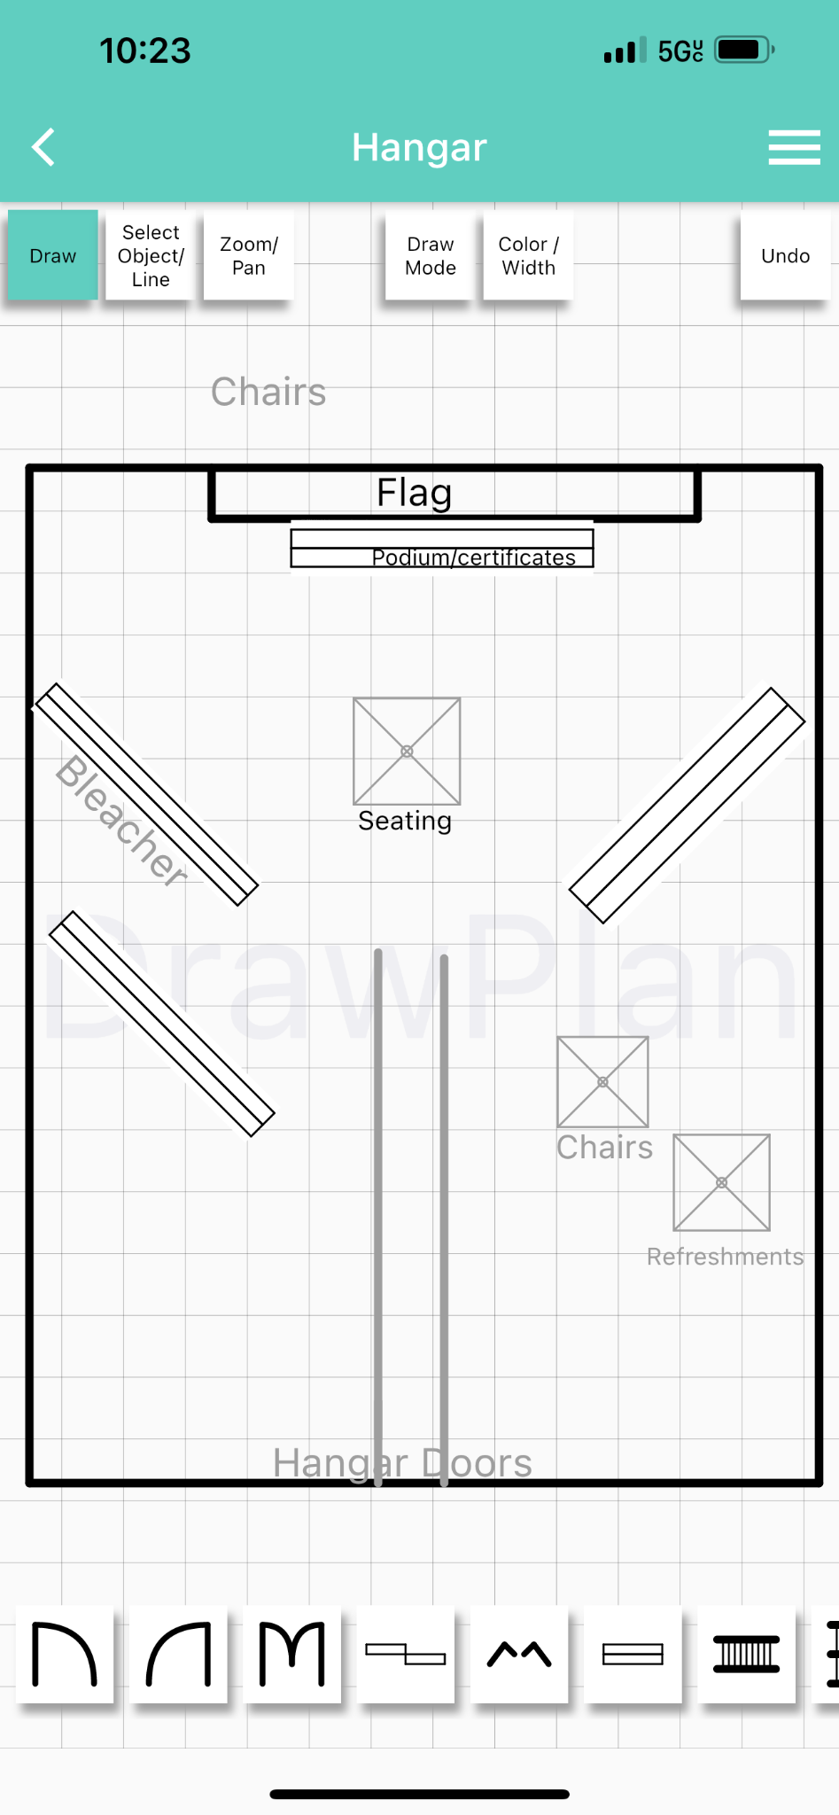
Venue Information
Air Force ROTC Detachment 842 • We Build Exceptional Officers • The University of Texas at San Antonio

Slide 14
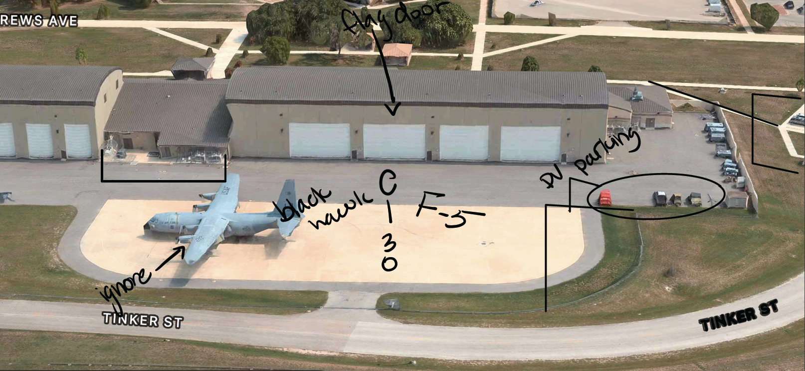
Venue Information
Air Force ROTC Detachment 842 • We Build Exceptional Officers • The University of Texas at San Antonio

Slide 15
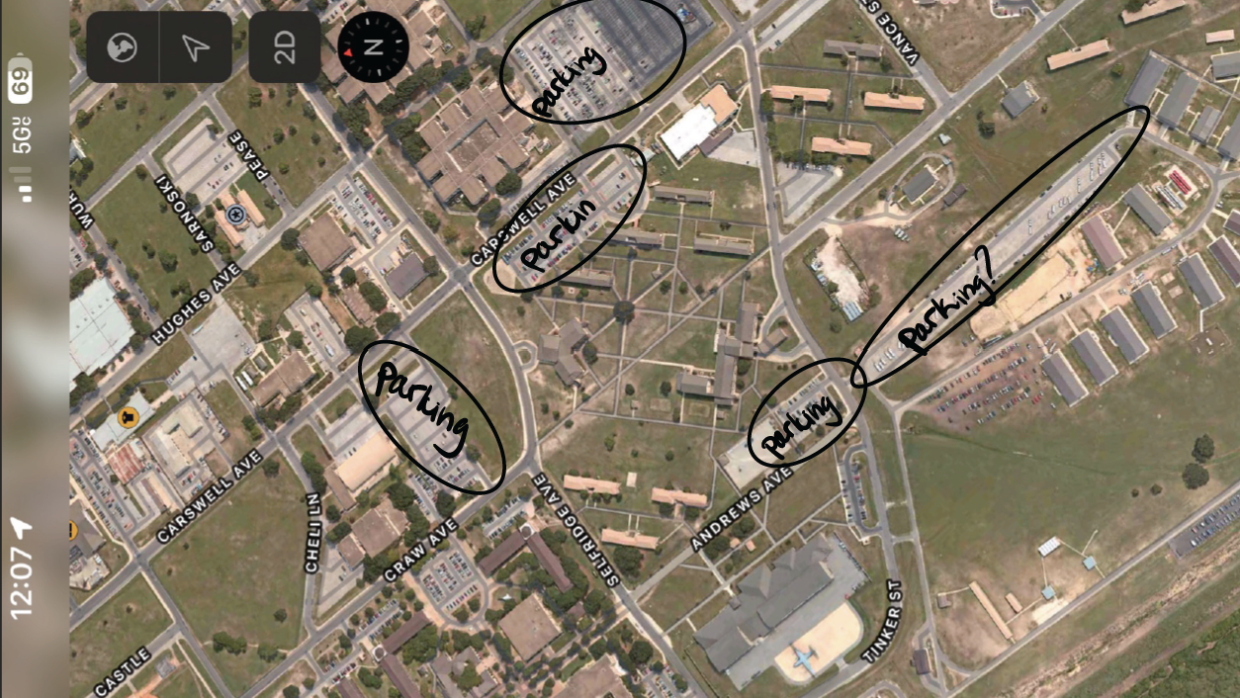
Venue Information
Air Force ROTC Detachment 842 • We Build Exceptional Officers • The University of Texas at San Antonio

Slide 16
Save The Date

Slide 17
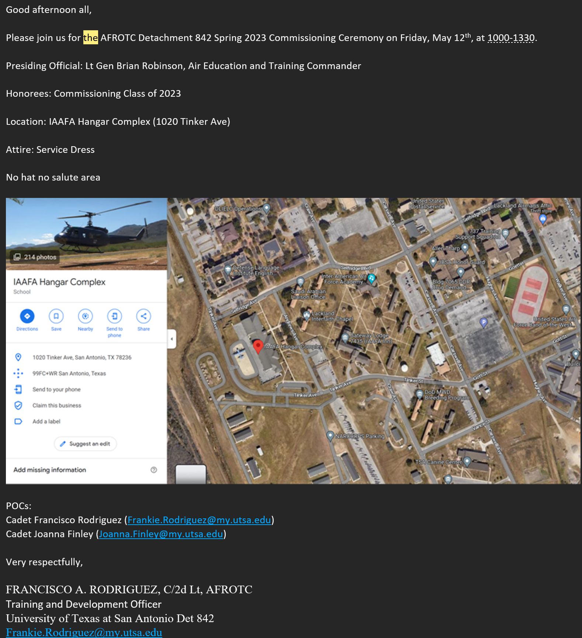
Save The Date
Air Force ROTC Detachment 842 • We Build Exceptional Officers • The University of Texas at San Antonio

Slide 18
Summary
Event Roles
Guest List
Script
Base Access
Venue Information
Save The Date
Air Force ROTC Detachment 842 • We Build Exceptional Officers • The University of Texas at San Antonio

Slide 19
Questions?

Slide 20
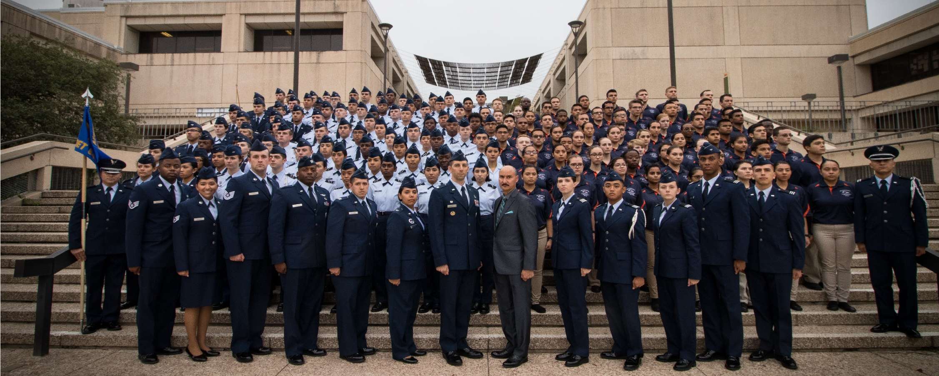
Air Force ROTC Detachment 842
The University of Texas at San Antonio
Det 842 – Best in Blue

